Slide 1
Julie Finnigan & Kelvin Montagu
Biofumigation

Slide 2
“Biofumigation offers the opportunity to improve soil health, lower the incidence and severity of soil borne pests and diseases, and achieve sustainable crop production outcomes”.

Slide 3
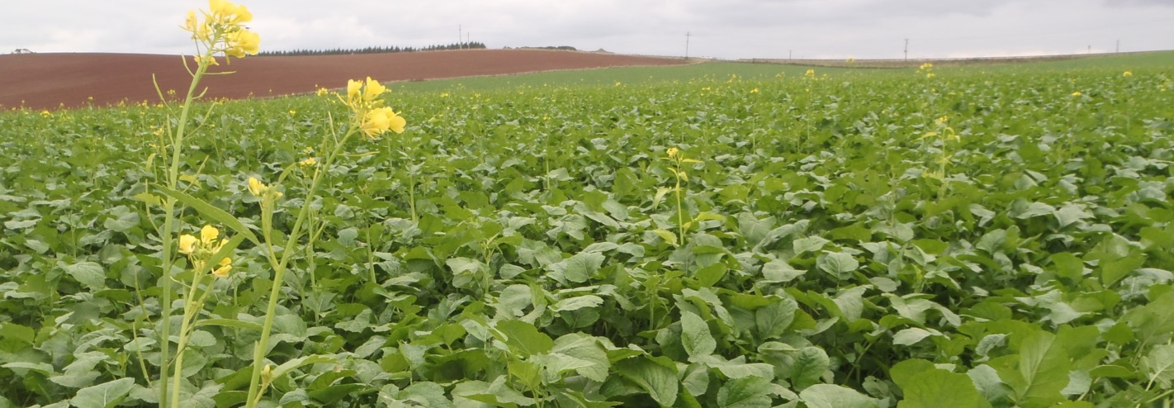
Biofumigation
What is Biofumigation?
The practice of growing brassica & mustard green manure crops that are high in biologically active compounds.

Slide 4
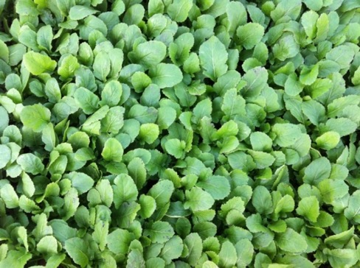
Biofumigation - History
Green manure crop
Long history
Targeted development of Brassica sp
1980’s onwards more intensive use

Slide 5
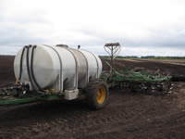
Biofumigation – Why?
Drive to find alternatives to chemicals
Methyl bromide
Metham sodium
Rising costs, legislation
Resistance, enhanced biodegradation
Sustainable management options
Toxicity, GHG emissions,
Market consumer demands
McDonalds in USA
1960’s – 1990’s 4.5M kg – 27M kg utilised

Slide 6
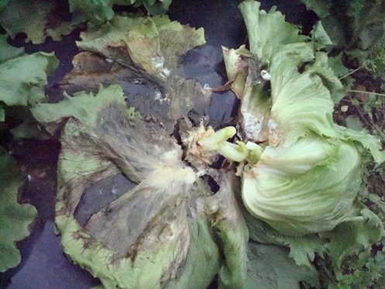
Biofumigation - Why?
Disease Control
Globally
2006 - $300billion crop losses
2009 - $400billion crop losses
2012 – 30% crop losses to pathogens
Cost to Australian horticulture?
$9billion industry

Slide 7
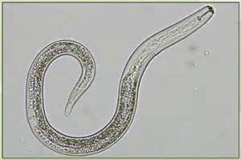
Biofumigation – Why?
Nematode Control
27,000 sp of Nematodes
Small % of likely total number of sp
4000 sp are plant parasitic
Global cost to production of $80billion(US)
High usage of Nematocides
options declining & growing resistance

Slide 8
Biofumigation – How?
The biofumigation process
Unbroken Cell
Macerated Cell
D. glucose
Myrosinase
Myrosinase
H₂O
Isothiocyanate
Glucosinolate
Glucosinolate
Nitrile
The Glucosinolate – Myrosinase System

Slide 9
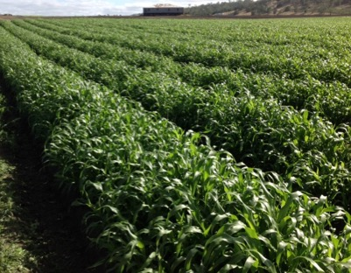
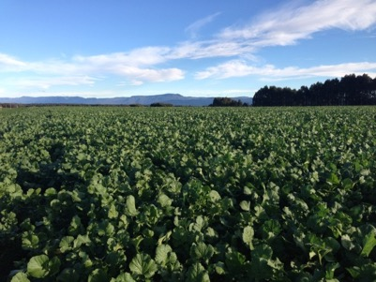
Biofumigation – Varieties
Brown Mustard, (Brassica juncea sp)
Rocket, (Eruca sativa)
White Oilseed Radish, (Raphanus sativus)
Sorghum (Sorghum sp)
Canola/Rape, (Brassica napus)
White Mustard, (Sinapis alba)
Black Mustard, (Brassica nigra)

Slide 10
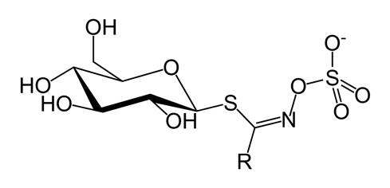
Biofumigation - Glucosinolates
Three main groups of glucosinolates
Aliphatic, Aromatic & Indolyl
200 different types
Plants & plant parts vary in concentration
Sinigrin
Glucoalyssin
Gluconapin
Gucobrassicin
Cyanogenic glucosides

Slide 11
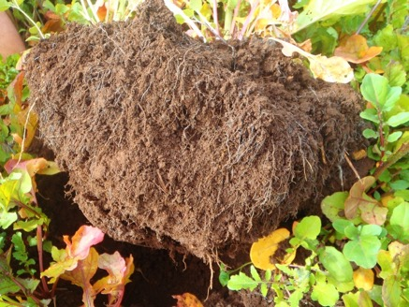
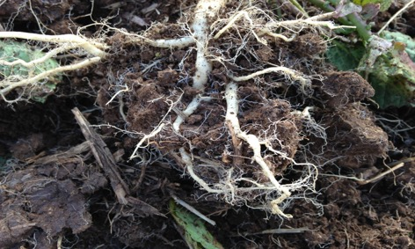
Biofumigation - Benefits
Potential benefits of a Biofumigant Crop
Increased nutrient scavenging
Enhanced disease & pest suppression
Increased weed suppression
Improved soil aggregate stability
Greater reductions in soil erosion
Improved soil microbial populations

Slide 12
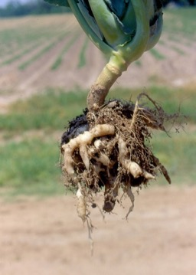
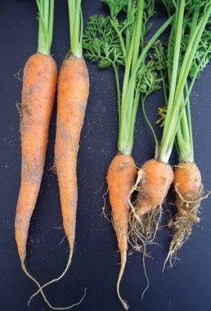
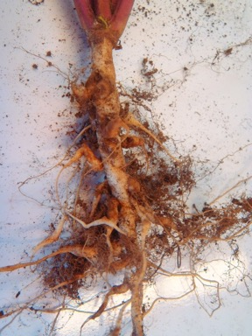
Biofumigation – Starting out
Variety selection for specific purpose
Host/non-host
Crop rotations
Disease suppression
Pathogen sensitivity
Nematode control
RLN, RKN

Slide 13
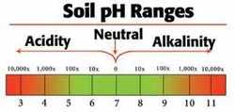
Biofumigation – Starting out
Agronomic criteria
Nutrition
pH
Soil and ambient temperatures
Soil moisture levels
Soil type
OM
Method of maceration
Timing of incorporation

Slide 14
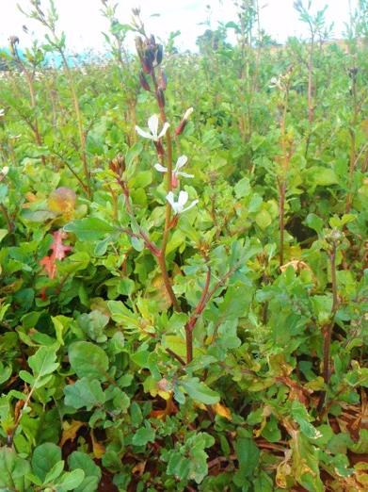
Variety selection
Mustards – Brassica juncea spp
Disease suppression
Sorghum – Fumig8tor
Multi purpose – diseases and nematodes
Rocket – Nemat (Eruca sativa)
Nematode catch crop
White Oilseed radish – Raphinus sativa
Nematodes, club root control

Slide 15
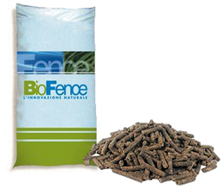
Variety selection
New Products
Mustard Meal & Pellets – Brassica juncea spp
Disease & nematode suppression
Soil Fertiliser/amendment
BioFlow – Brassica juncea spp
Liquid foliar fertiliser
Rojo – Brassica juncea spp
New super hot variety

Slide 16
Disease sensitivity
Sensitivity of soilborne fungi to Thio-GL-DPs
Pathogen | IC₅₀ (mM) | Sensitivity
Phytophthora cactorum | 0.005 - 0.05 | High
Phytophthora nicotiana
Pythium irregulare
Pythium ultimum
Rhizoctonia solani | 0.05 - 0.1 | Medium
Sclerotium rolfsii
Fusarium oxysporum | 0.1 - 0.5 | Low
Verticillium dalhiae
Sclerotinia sclerotiorum
Pyrenochaeta lycopersici
Trichoderma harzianum

Slide 17
Disease sensitivity
Total fungi one month after green manure simulation
cfu g⁻¹ soil
300000
a
a
250000
b
b
200000
b
b
150000
c
d
100000
50000
0
B. juncea
ISCI 20
B. juncea
ISCI 99
Rapistrum
rugosum
ISCI 4
B. juncea
ISCI 34
Barbarea
Verna
ISCI100
Untreated
00 Rapeseed
Pigeon
bean
International South Europe Symposium, 15-16 Maggio 2003 - Bologna –Italy – Courtesy D.Gies

Slide 18
Disease sensitivity
Pythium spp. one month after green manure simulation
Cfu g⁻¹ of soil
a
4500
b
3500
c
2500
d
1500
e
e
e
e
500
Untreated
ISCI 20
ISCI 99
R. Rugosum
ISCI4
ISCI 34
B. verna
ISCI100
00 rapeseed
Pigeon
bean
International South Europe Symposium, 15-16 Maggio 2003 - Bologna –Italy – Courtesy D.Gies

Slide 19
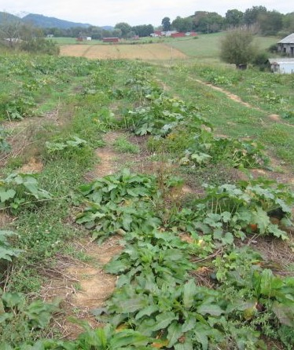
Disease suppression
Dr. Straw, West Virginia
Courtesy; D.Gies 2015

Slide 20
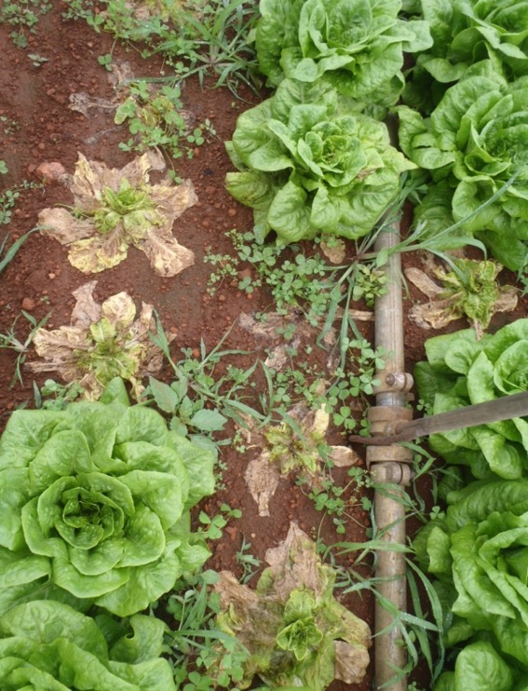
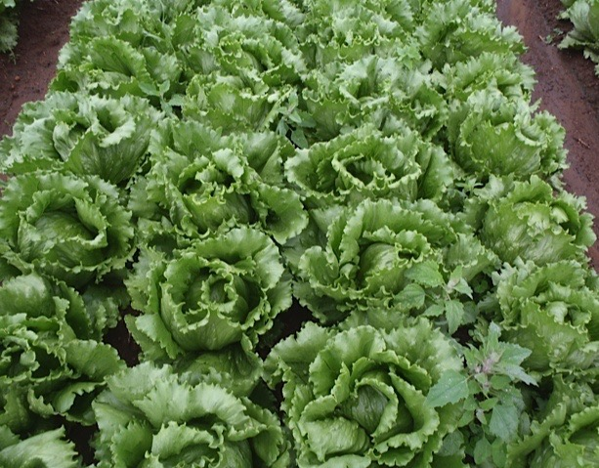
Disease suppression
Control: ‘Damping off’ & Sclerotina
Caliente: Less disease & weeds
David East, WA. Photo courtesy of D.Gies 2015

Slide 21
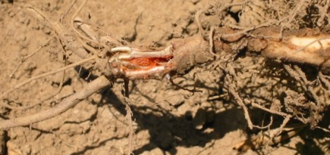
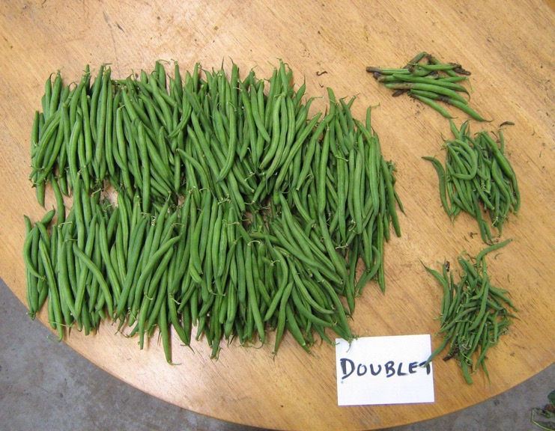
Disease suppression
Reduction in root rot (Fusarium) incidence
35% increase in yield
Serve-Ag & Peracto

Slide 22
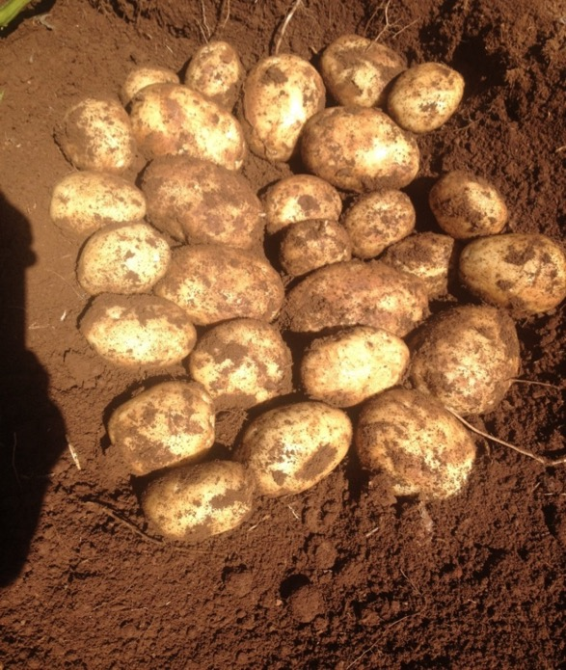
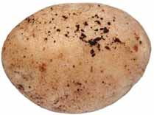
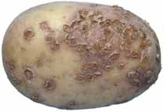
Disease suppression
Black scurf
(R. solani)
Powdery scab
(S. subterranea)
0-2% v 75%
2-5% v 15%
Shortened rotations
Reduced chemical inputs
Reduced fertiliser inputs
Serve-Ag & Peracto

Slide 23
Disease suppression
69t/ha
64t/ha

Slide 24
Disease suppression
Commercial Strawberry Trial
Control
Caliente
Courtesy; D.Gies 2015

Slide 25
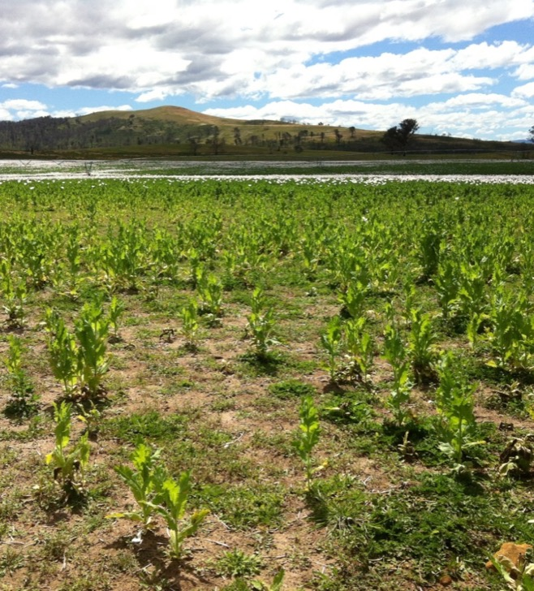
Increased yields
Control
Caliente
Total C increase
1.6% - 2%

Slide 26
Increased yields

Slide 27
Nematode control
Variety Selection important
Eruca Sativa (Nemat)
Catch crop
Effective on RKN, PCN, BCN
Oilseed radish
Fumig8tor

Slide 28
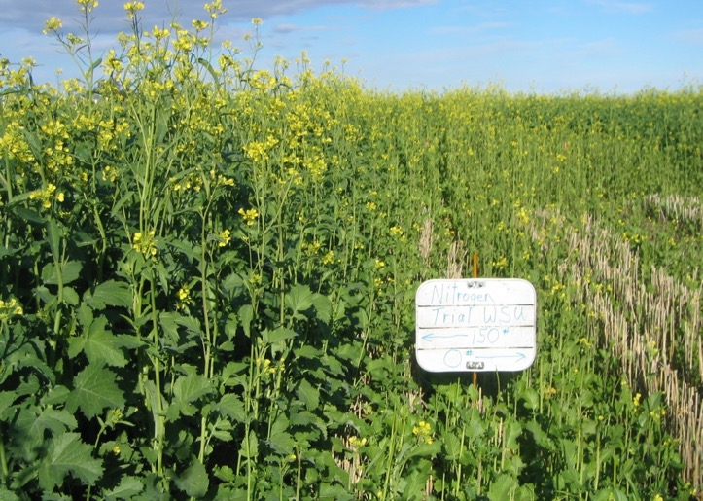
Nutrition
Growth and biomass
Weed suppression
Glucosinolate production
Nutrient recycling
Microbial requirements
ITC generation
Courtesy; D.Gies 2015

Slide 29
Nutrition
Test your soils
Only apply what you need to
Fertiliser applied will be available to following crop
Essential for glucosinolates

Slide 30
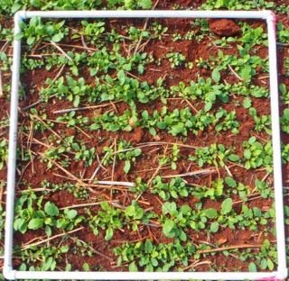
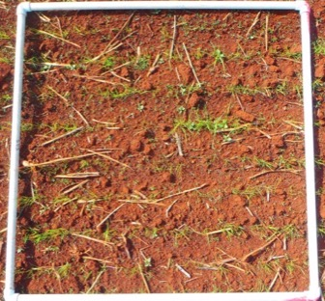
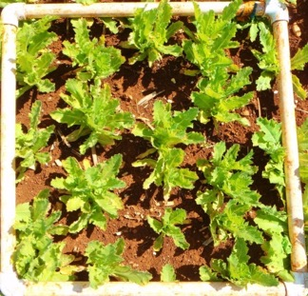
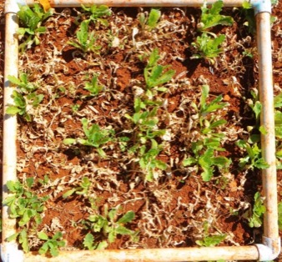
Weed suppression
In Situ Benefits
Rapid growth
ITC release from roots
Post Maceration benefits
ITC burn off weed seeds
Improved health & growth of crop
Soft seeded – limited weed potential

Slide 31
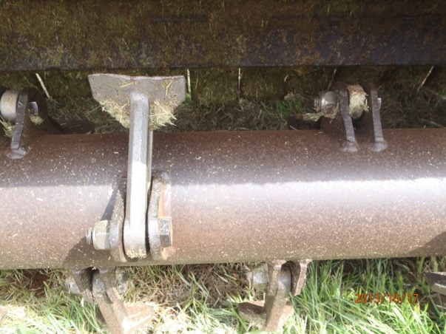
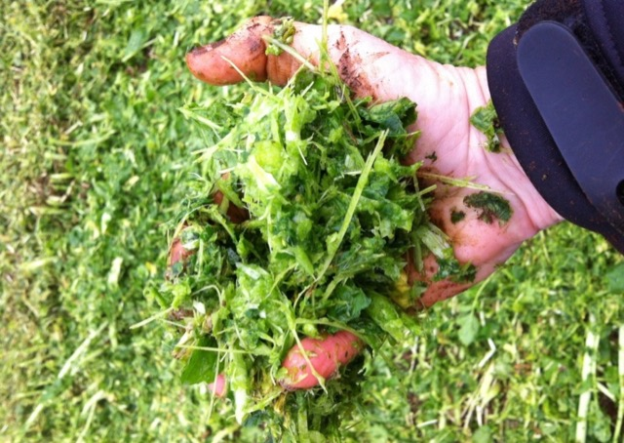
Maceration Guide
Aim for fine maceration of plant
Flail chopper with hammer blades

Slide 32
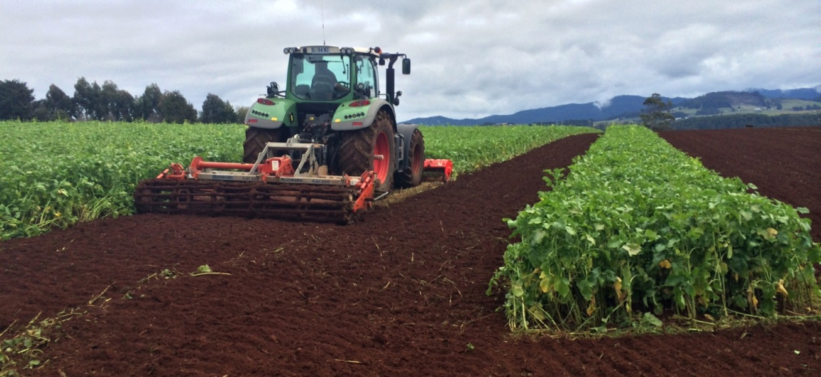
Incorporation Guide
Rapid incorporation required 20 mins

Slide 33
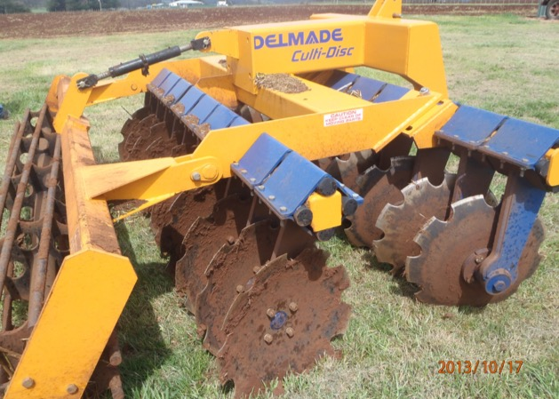
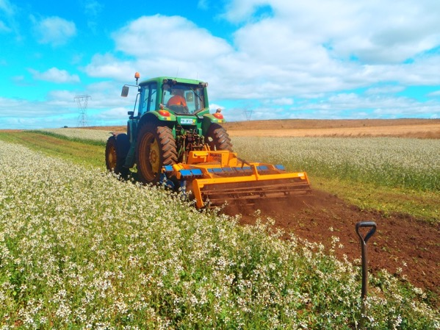
Incorporation Guide
Discing provides the most even incorporation

Slide 34
Incorporation Guide
Macerate only if soil moisture is suitable
AVOID WET SOILS
Irrigate lightly to help seal in ITC’s
Time incorporation to precede rainfall

Slide 35
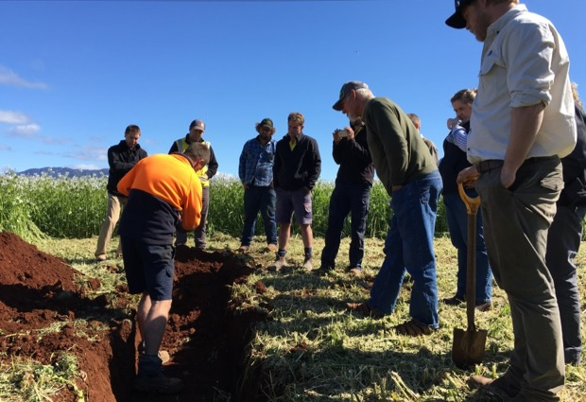
Incorporation Guide
Do not sow following crop within 2-3 weeks
Biofumigant active for up to 90 days
Soil health benefits on-going
Darren Long of Sheffield –
Fuel consumption halved
RPM’s on power harrow halved
Improved soil structure
Shortened rotation
Pack-out’s increased

Slide 36
Cost -Benefits
Things to Consider:
Establishment & management costs more expensive
Timing difficulties (mulching & crop rotations)
Longer term returns gained
Less herbicide generally required
Fertiliser applied is returned to next crop
Improved soil structure
Reduced irrigation requirements
Improved drainage
Improved yields & quality
Suppression of pests & diseases
Reduced mechanical soil preparation
Fuel & time saving

Slide 37
Summary
Biofumigants are not a silver bullet
Timing of management is imperative
Initial costs – longer term savings
Good management – multiple benefits
Proactive management of soils
Precision Ag helps to refine management

Slide 38
Thank You

